Slide 1
Team gradeDescent
Final Project Presentation

Slide 2
Cool things we achieved
Going after guizmo
Malfunctioning leg
Rotating on point
Different gait patterns
Notes:
Our main goal is to steer a hexapod as autonomous as possible. This should allow us to later execute tasks such as calculating paths, lifting objects and walking around with injuries.
Nic: now that’s some pretty cool stuff

Slide 3
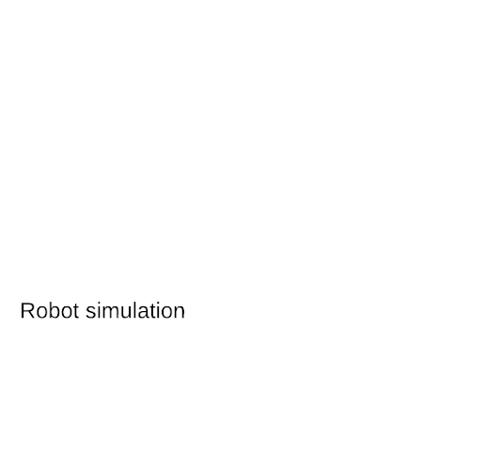
Where did we start?
Reference torques
Full robot state
Notes:
Let me take over here and tell you how we went about this project from the bottom up
Let’s start at the very beginning, where you have provided us with a simulation environment and a rather “imobile” hexapod robot in it
In order to make it move, we would have to put some torque on its joints, but how to compute them?
https://app.lucidchart.com/invitations/accept/3a985dfd-981d-4029-bc09-160393ff7d97

Slide 4
Problem Statement
“Given motion tasks for the base and each foot, what joint torques are required to perform this motion?”
Our approach: Operational Space Control
(with increasing complexity)
Notes:
So we were facing the following problem statement:
“Given motion tasks for the base and each foot, what joint torques are required to perform this motion?”
Realizing that you provided us with powerful tools such as a generalized coordinate space representations of the robot as well as an SQP solver and with some inspiration from the lecture, we figured, we’d try Operational Space Control
And since that is rather complex, we started out pretty simple

Slide 5
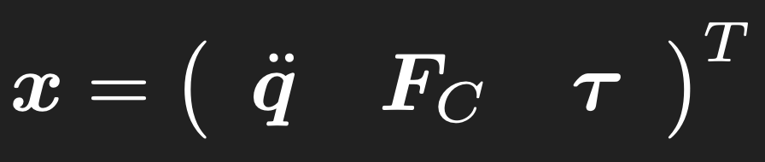


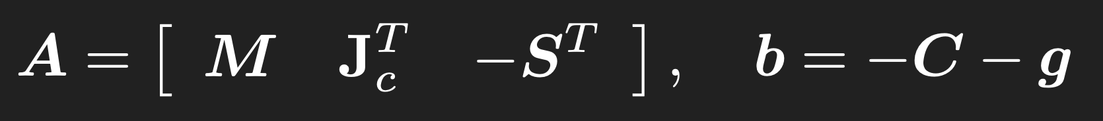
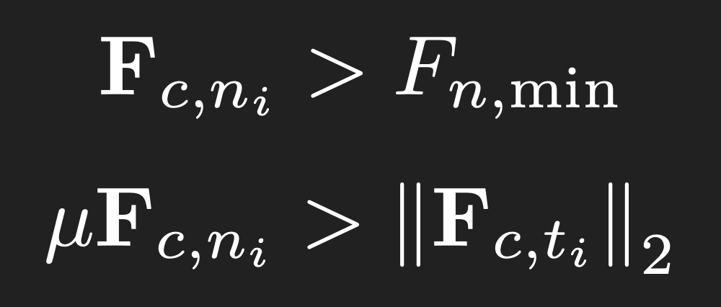

Operational Space Control
Use provided SQP minimizer to solve a constrained optimization problem
Formulate objective and constraints as quadratic programs
Objective on motion tasks of base and feet
Equations of Motion (EoM) as constraint
Constraints on contact forces (linearized friction cones) and torque limits
Notes:
From theory, we knew that an SQP solver takes as input a constrained optimization problem formulated in terms of quadratic programs
As for the objective, we enforce a soft constraint on the desired motion tasks, relating joint accelerations and velocities to accelerations in operational space w_dot
This is convenient since it’s much more intuitive to command EE around in cartesian x, y, and z rather than joint space q
In order to keep the robot upright while moving around EE, the Equations of Motion would have to be fulfilled as a hard constraint
Now, introducing as state x the joint accelerations, contact forces, and joint torques, the equations can be rewritten in a more convenient form as A*x = b
Later on in the project, we’ve added more constraints such as linearized friction cones and torque limits (not to forget a tiny little regularizer in the objective, which is my main learning from a semester of CMM)

Slide 6
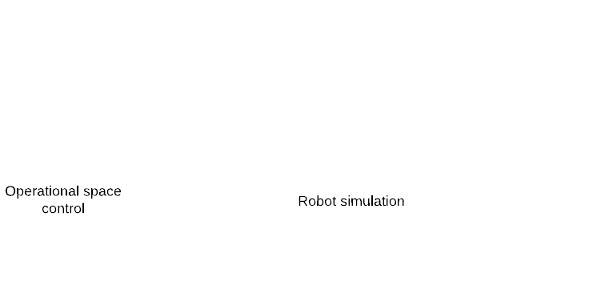
Operational Space Control
Reference torques
Full robot state
Holding the initial robot pose
Notes:
So much about theory, but how did it perform in practice?
Starting out small, we just tried to hold the initial robot pose and getting the SQPMinimizer to find a solution for the state x (printed into my terminal)
Worked!
https://app.lucidchart.com/invitations/accept/3a985dfd-981d-4029-bc09-160393ff7d97

Slide 7
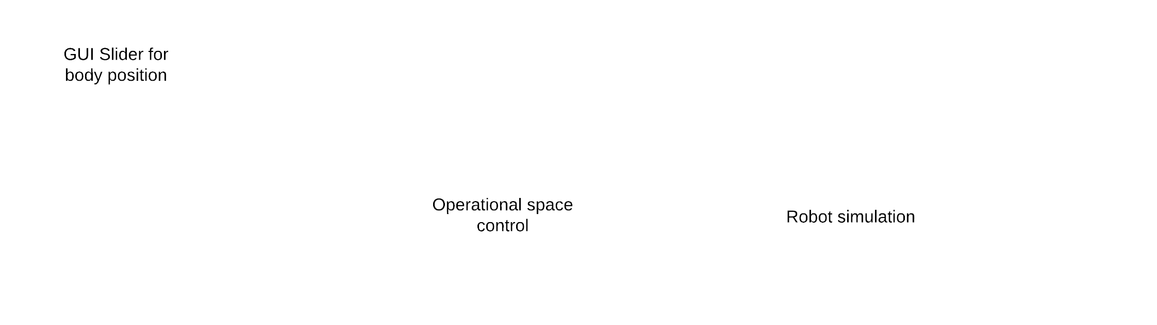
Operational Space Control
Reference base and feet state
Reference torques
Full robot state
Holding the initial robot pose
Moving the base around
0
Lifting legs to arbitrary positions
Notes:
Now, it was time to get things moving
First, we tried motion commands for the base with all feet still on the ground
For this, we provide a little slider interface to interact with some rigid bodies of the robot
This also worked like a charm! (If only it wasn’t for the slow solver though…)
As a final step, we wanted to lift legs off the ground and move them to desired positions in cartesian space
Took us a while to realize how to disable some foot’s contributions to the EoM, but once we replaced that particular foot’s contact jacobian with zeros, things worked out.
This completes our operational space controller as it now provides a clean interface to steer the robot’s base and all feet

Slide 8
Base and Foot Motion Planner
Notes:
Moving base and feet? Sounds a lot like walking

Slide 9
Problem Statement
“Given a desired constant base velocity and desired constant turning rate how should the base and the legs be accelerated?”

Slide 10
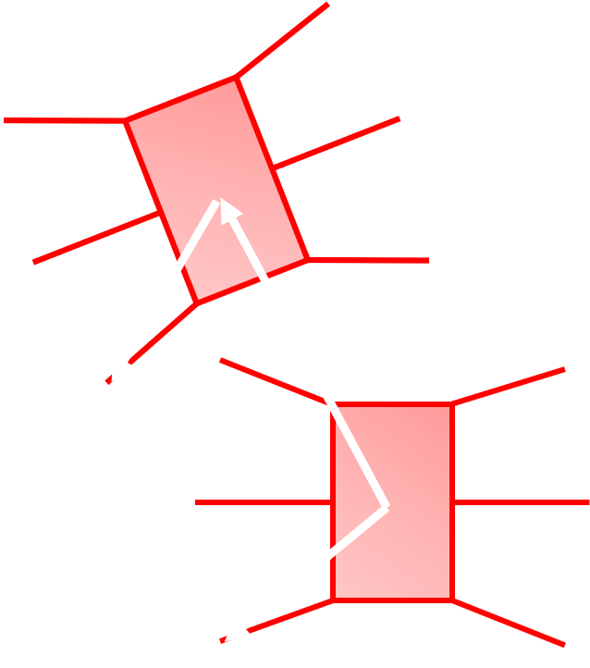
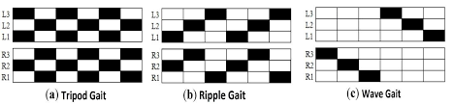
Base and Foot Motion Planner
Target foothold calculation of swing legs
Periodic
Predict after each stride:
Base position
Base orientation
The math behind this is documented in the backup slides.
Target foothold position
https://etd.ohiolink.edu/!etd.send_file?accession=wright1514915943875043&disposition=inline

Slide 11
Base and Foot Motion Planner
Higher order polynomials as reference foot trajectories
Constraints and objective
Zero initial and final velocity and zero initial and final acceleration
Initial leg position at beginning and target foothold position at end of stride
Maximum foot height is restricted
Simplification: no specific optimization of leg trajectory
Given perfect model knowledge, no PD control but feedforward of reference acceleration given from the trajectory → zero tracking error (of course not robust to disturbance)

Slide 12

Base and Foot Motion Planner
Reference torques
Full robot state

Slide 13
Base and Foot Motion Planner
Desired or reference base velocity
Reference base and feet state
Reference torques
Full robot state

Slide 14
Base Trajectory Planner

Slide 15
Problem Statement
“Given a desired target position and target orientation which reference base velocity and turning rate has to be applied to the base and foot motion planner?”

Slide 16
Base Trajectory Planner
Simple constant reference velocity and constant turning rate base trajectories
Allows for zero tracking error if target position and orientation are on a circle
Otherwise it minimizes the distance to the target position
Satisfies constraints on maximum base velocity and turning rate
The math and the logic of the planner is documented in the backup slides

Slide 17
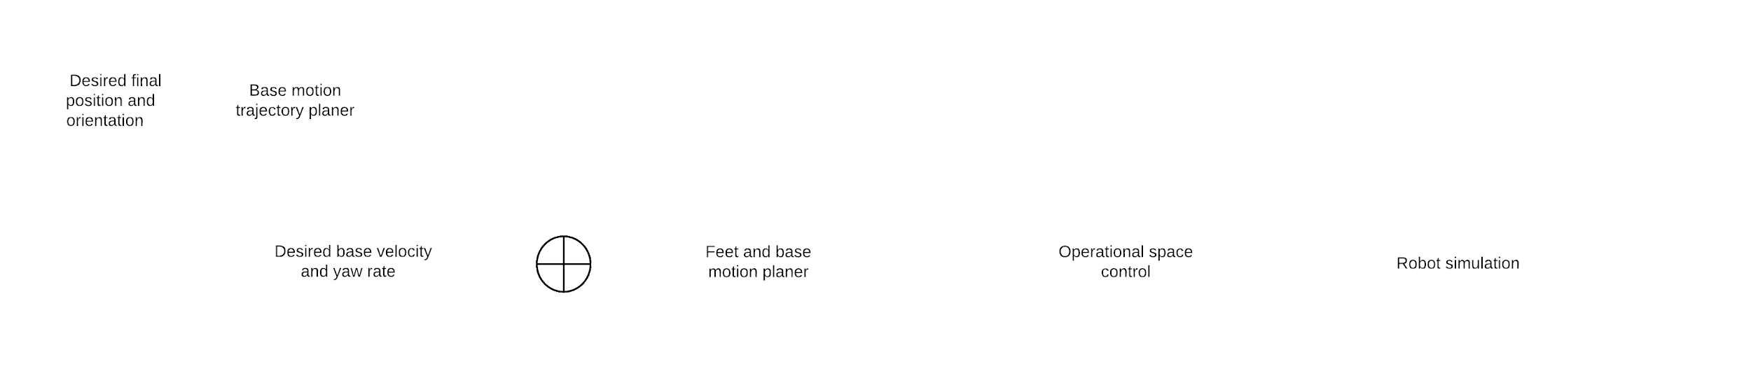
Full Architecture
Desired or reference base velocity
Reference base and feet state
Reference torques
Full robot state

Slide 18
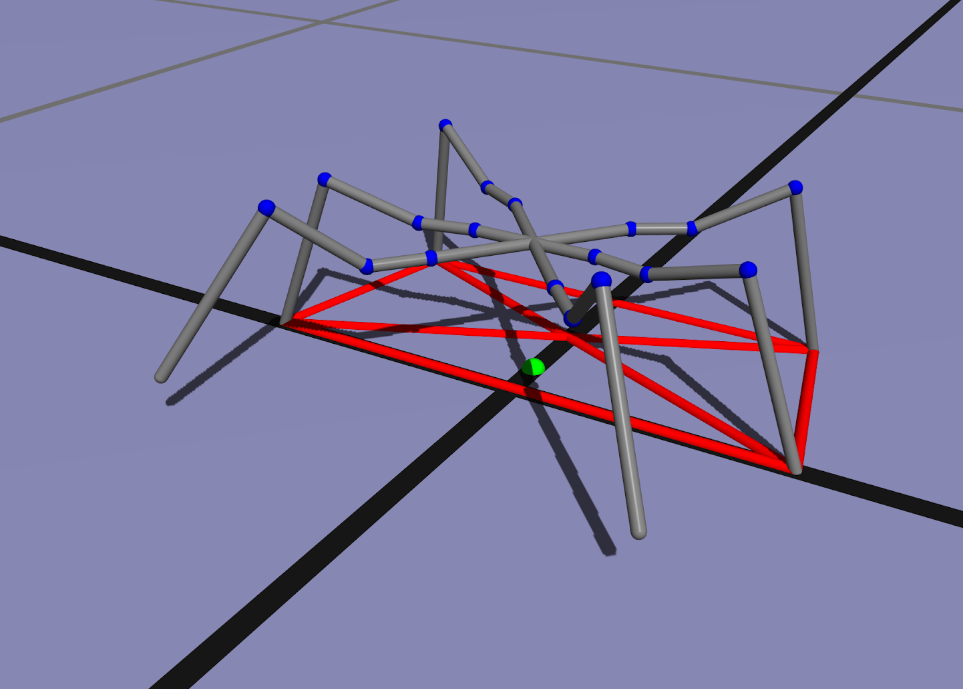
Extra Feature: Lifting Objects
Bottom-Up approach:
Disable calculation of lifting foot paths
Disable influence of the contact force to the EoM
Result:
Understanding that center of gravity has to be within the stability region
Next step: optimization of stability region with respect to center of gravity
Not in scope of this project anymore
Notes:
Hm so you say your quite autonomous now? This was taken to a test. The goal was to create a lifting motion, what is in our opinion one of the main advantages of a six legged robot. As a first step, we disabled the calculation of the lifting foot paths in the motion planer. Second the influence of the contact force to the EoM was disabled. As a result, as soon as the first leg was lifted, the center of gravity was not in the stability region anymore. This lead to the understanding that a optimization for the stability region would have to be done to provide stability. Unfortunately, this was a that time of the project not in the scope anymore.

Slide 19
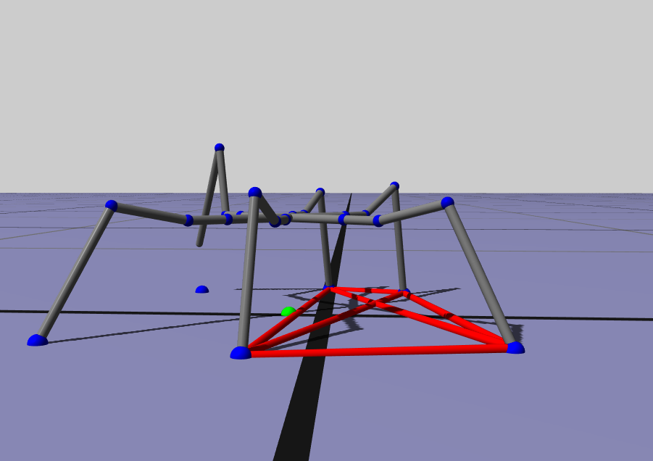
Extra Feature: Walking with a malfunctioning Leg
Bottom-Up approach:
Disable malfunctioning leg
Disable influence of the contact force to the EoM
“Lean” in opposite direction of malfunctioning leg to improve stability
Optimize foot pattern as a quick fix for a optimized stability region
Notes:
Naive as we are, we thought reacting to and walking with a malfunctioning leg is not as critical regarding the stability region. We disabled the malfunctioning leg and set its objectives to keep its position. We again disabled the influence of the contact force to the EoM. We hardcoded a leaning posture in the opposite direction of the malfunctioning leg to improve stability and optimized the foot pattern as a quick fix for a optimized stability region.

Slide 20
Limitations and outlook:
Goal achieved?
Potential next steps:
More flexible base trajectories
Optimizing the region of stability
Rethinking of the control architecture
Replace remaining hard coded parameters by situationally dependent parameters
Notes:
Did we reach our goal? In principle yes, we successfully applied theories learned in the course and build a framework to navigate our hexapod autonomously . It was not implemented to the finest details due to time reasons which shows when trying to fulfill difficult high level tasks. However, we see clear problems which would be solve next: Reach more flexible base trajectories by applying none constant velocities. Optimizing the region of stability to grant more difficult gaits. By rethinking of the control architecture and replacing the remaining hard coded parameters by situationally dependent parameters

Slide 21
Backup Slides

Slide 22
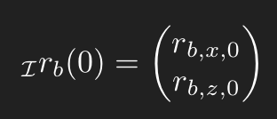

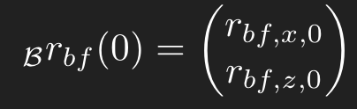

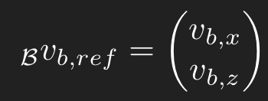
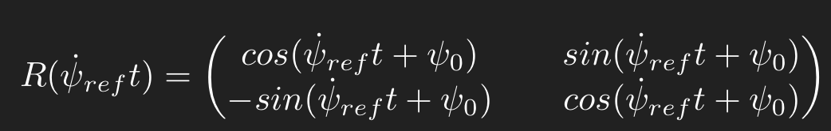
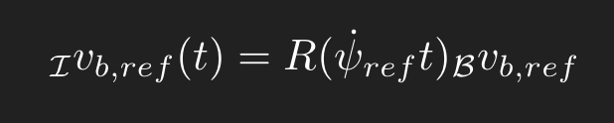
Base and Foot Motion Planner
Given the
initial position of the robot ,
initial heading of the robot ,
vector from initial base to each leg ,
reference turning rate ,
reference base velocity w.r.t base frame .
The reference orientation for a time t is
.
By applying the reference orientation we get the reference base velocity w.r.t inertial frame as .

Slide 23
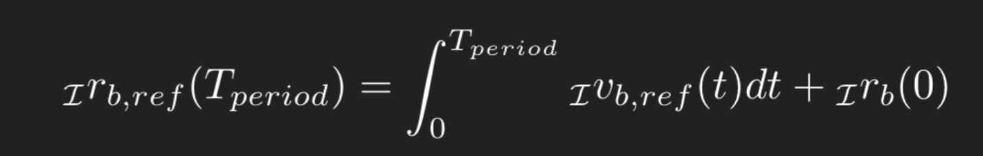
Base and Foot Motion Planner
Integrating the reference velocity leads to the reference position at the end of the period
.
Finally, we can put things together and get the target foodhold position for the swing legs as
.

Slide 24
Base and Foot Motion Planner
Simple constant velocity and constant turning rate trajectory for base
Pitch and roll of base stabilized by applying zero reference orientation, angular velocity and acceleration
Maximum feasible reference base velocity, turning rate and minimal period time experimentally evaluated (restrict them before leg overreach or collision)

Slide 25
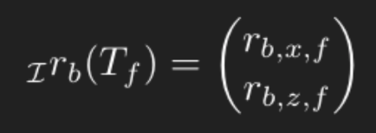


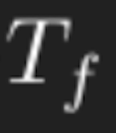
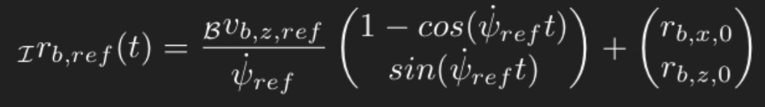
Base Trajectory Planner
Given the
initial position of the robot ,
initial heading of the robot ,
final position of the robot
and final heading of the robot .
What are
reference turning rate ,
reference base z-velocity w.r.t base frame ,
and final arrival time .
By applying the formula from slide before, we get for the reference base position .

Slide 26
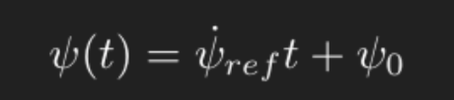
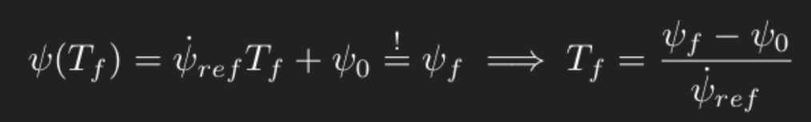
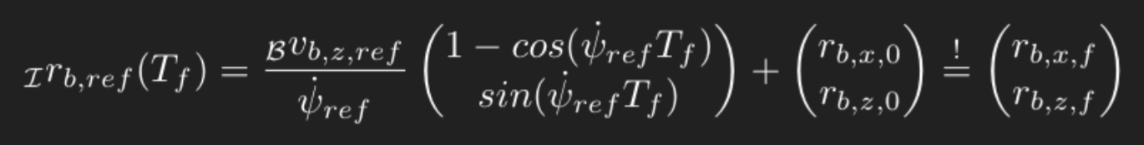
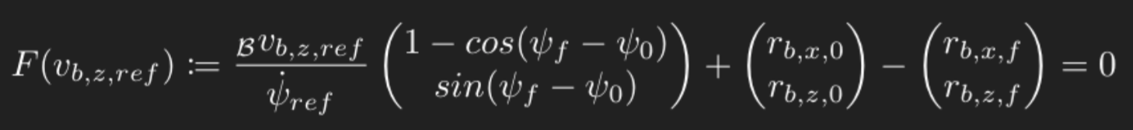
Base Trajectory Planner
By integration, the reference yaw angle simply leads to
.
To arrive at the given final orientation we have to apply
.
To arrive at the given final target it has to hold
.
We apply the expression for the final time into the previous equation and get
.

Slide 27
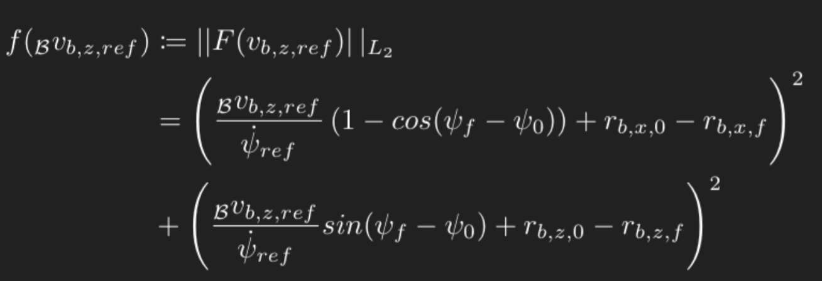
Base Trajectory Planner
The previous equation can be interpreted as follows: if the choice of the target position and orientation is feasible then we can find a combination of velocity and turning rate such that this equation is satisfied.
We can formulate the following objective function
. .

Slide 28
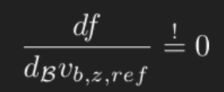

Base Trajectory Planner
If a choice of velocity and turning rate causes that both addends in the objective yield zero then the target is completely feasible. Otherwise the objective has to minimized as follows:
.

Slide 29
Base Trajectory Planner - Algorithm
Test whether target is completely feasible. (i.e. both addends zero)
If yes, test if target can be achieved in minimum time (i.e. apply maximum turning rate) without violating the constraint on the velocity.
If yes, done.
If no, test whether we can achieve the result by applying the maximum velocity without violating the constraint on the maximum turning rate.
If yes, done.
If no, Go to 2.
If no, go to 2.
Choose the solution which brings the gradient to zero for the highest possible turning rate (i.e. smallest final time) and which does not violate the constraints. (Multiple iterations)

